Slide 1

The Ames Oracle
An Automated Real-Estate Valuation Model
By: Raj

Slide 2
Requirements
Predict
Develop an automated valuation model for housing data from Ames using fixed features.
Predict
Develop an automated model that can help in making the decision if a particular house should be bought and renovated for making extra profit.

Slide 3
Data ETL
Following Columns have Nulls for 85% of rows - Alley, PoolQC, MiscFeature, Fence. We Drop them
Nulls in following columns are actually Categories
'GarageCond','GarageFinish','GarageQual','GarageType’
'BsmtCond','BsmtExposure','BsmtFinType1','BsmtFinType2','BsmtQual’
‘FireplaceQu’, 'MasVnrType’.
Nulls in GarageYrBuilt are replaced with data from house YrBuilt.
Nulls in Lotfrontage and MsnVnrArea are replaced with the median values.

Slide 4

A Minimum Viable Oracle EDA

Slide 5
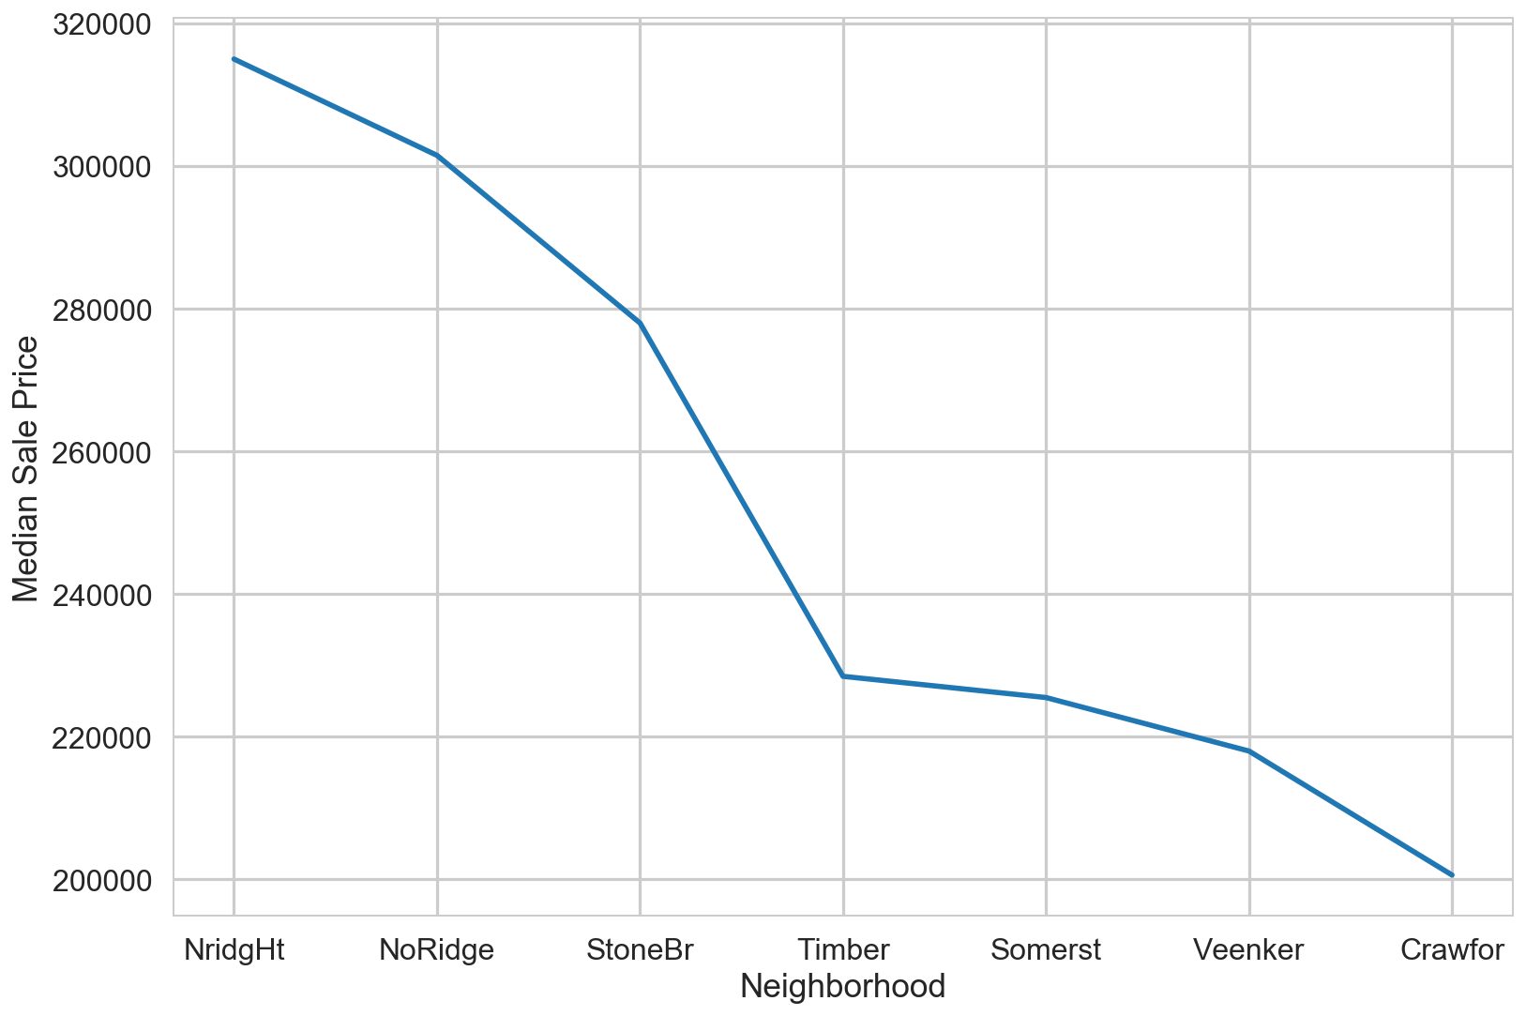
Median House Price Based on Neighborhood

Slide 6
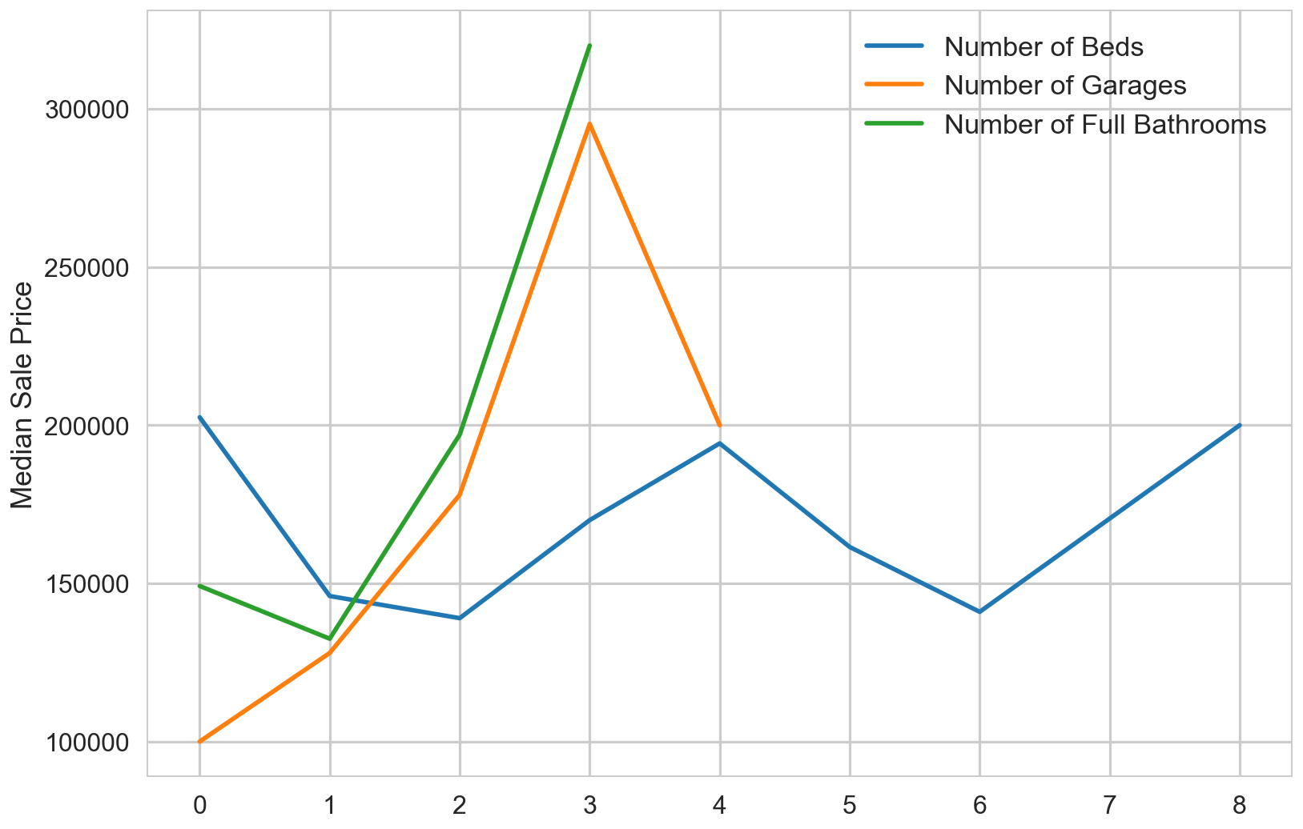
The house price based on Number of Bedrooms, bathrooms and Garages

Slide 7
A Linear Oracle

Slide 8
Prepare the data
Decide the Fixed and renovatable features.
Dummyfy the Categorical Variables and Standardize the Numerical Variables.
This gives 181 variables for creating the predictive model.

Slide 9
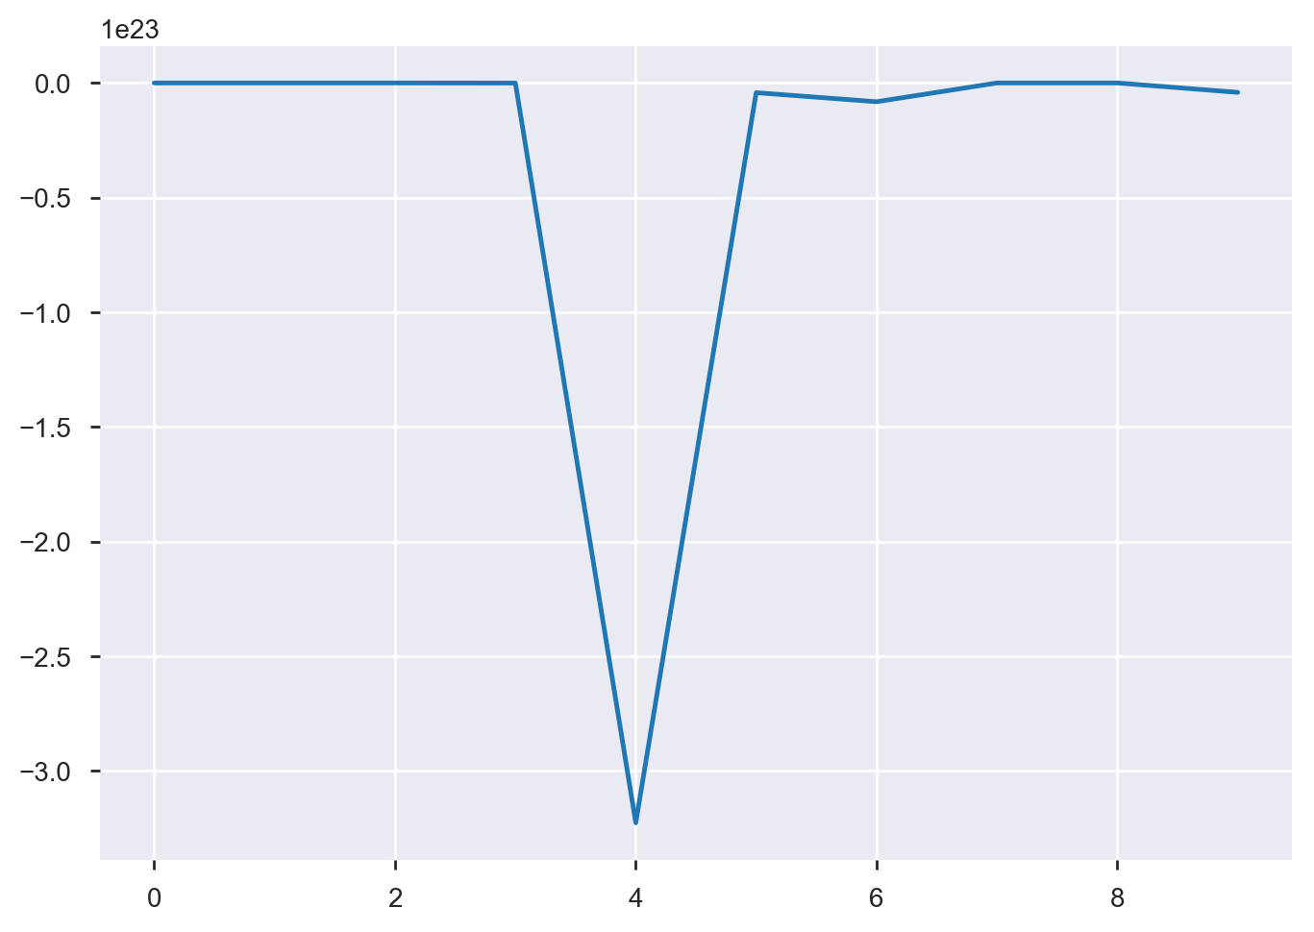
An Overfitted Model
We feed all these columns to linear regression model and perform 10 fold Cross Validation. This gives a mean score of -3.39 x 10 ²² and standard deviation of 9.62 x 10 ²³.

Slide 10
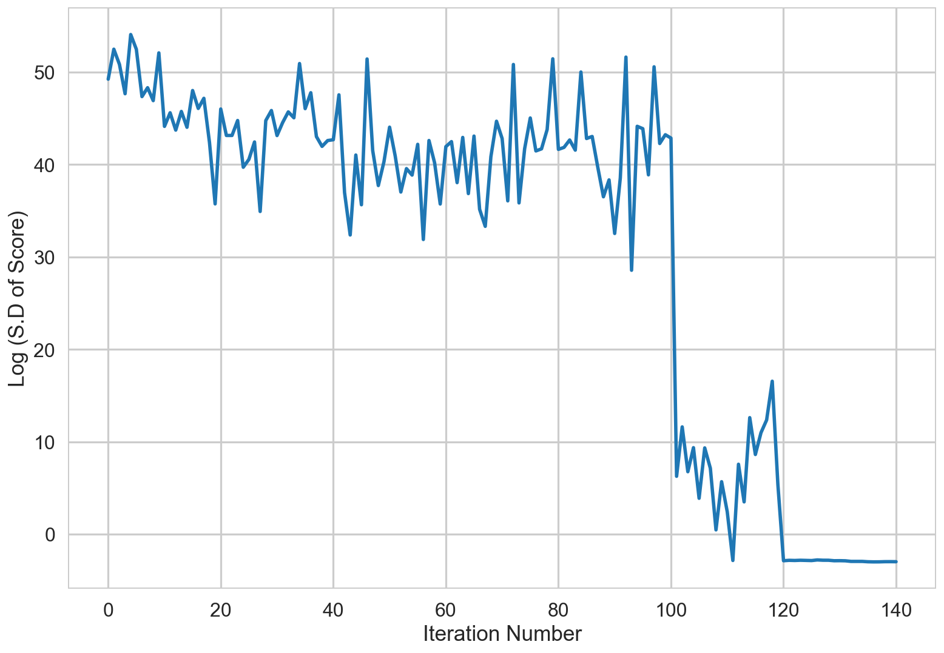
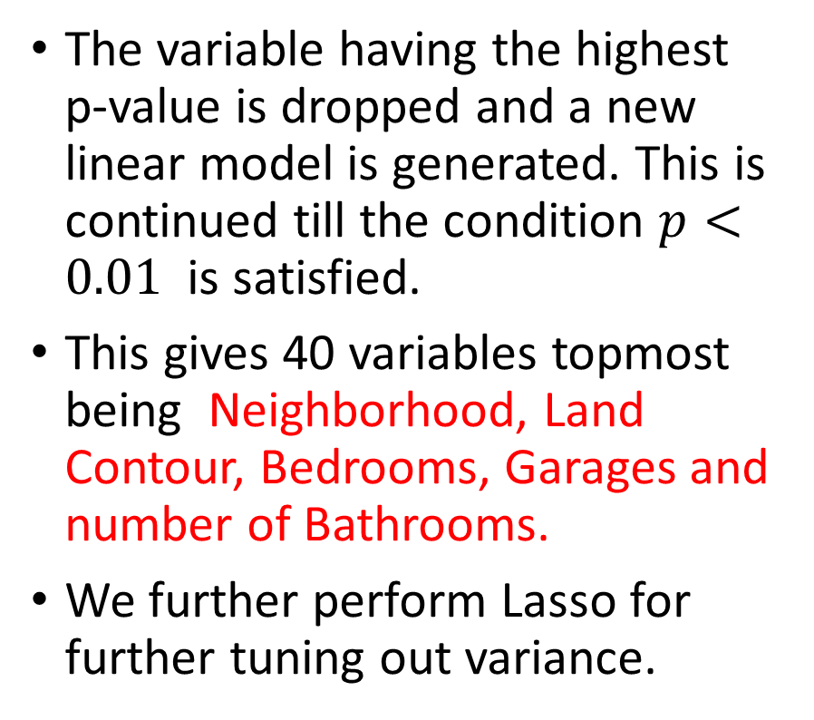
Feature Selection
The variable having the highest p-value is dropped and a new linear model is generated. This is continued till the condition $p<0.01$ is satisfied.
This gives 40 variables topmost being Neighborhood, Land Contour, Bedrooms, Garages and number of Bathrooms.
We further perform Lasso for further tuning out variance.

Slide 11
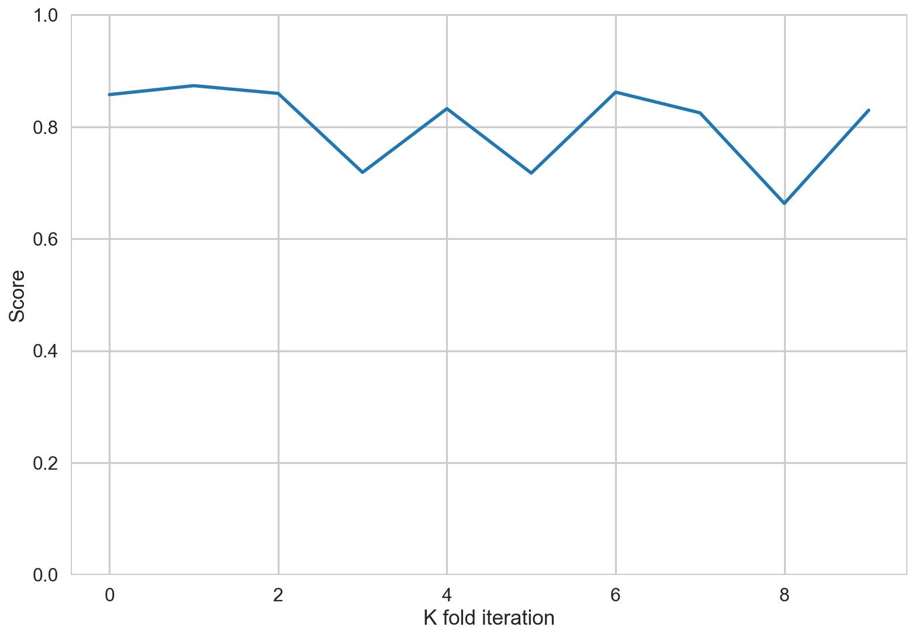
And Stability ensues …
Mean of 10 fold CV Scores = 0.817
S.D of 10 fold CV Scores = 0.069

Slide 12
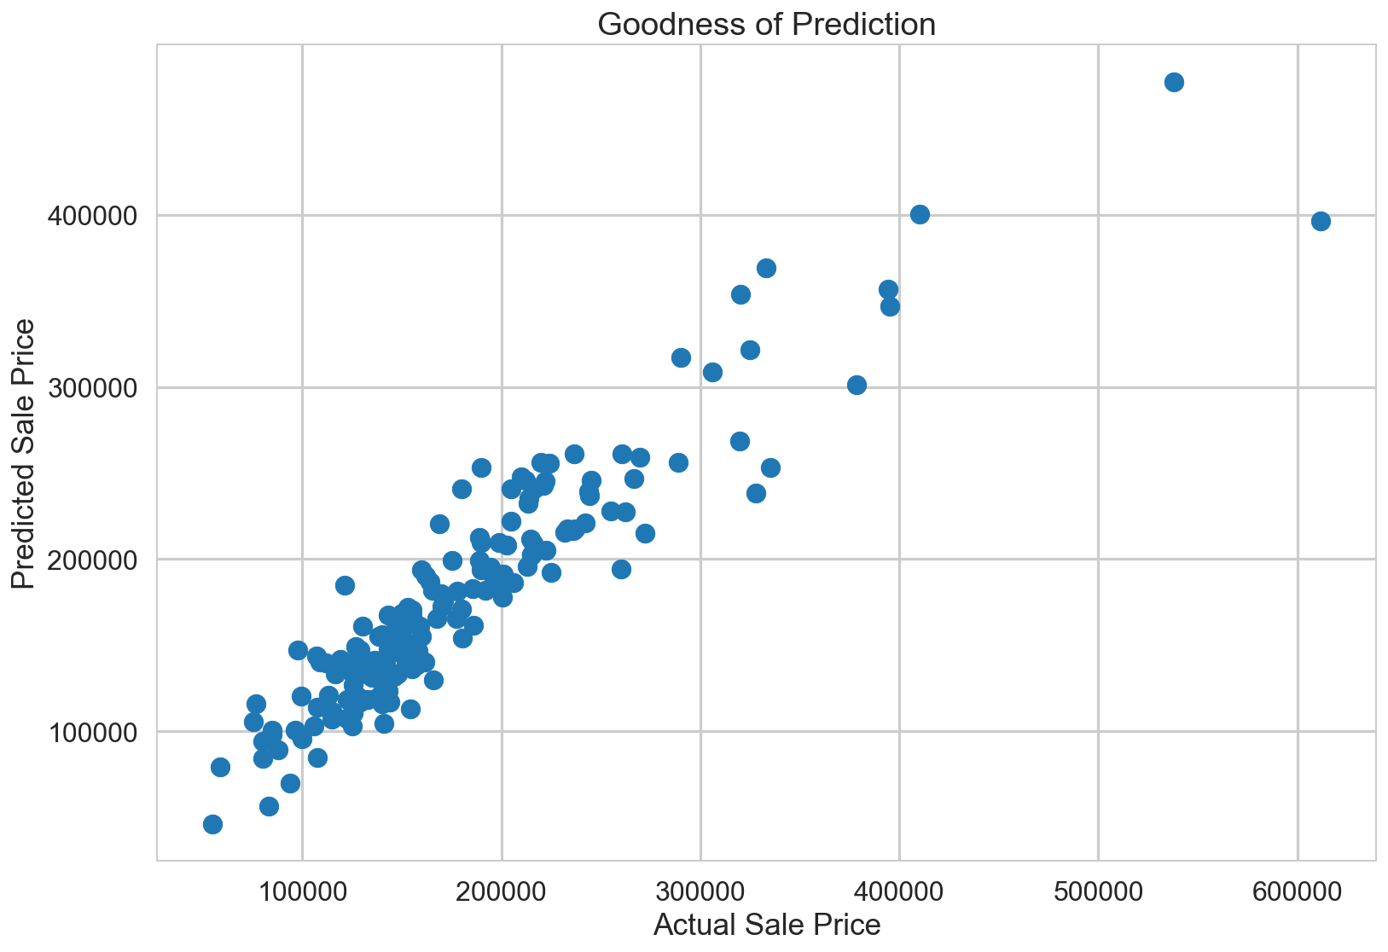
Good ness of fit
Own Score = 0.86 Test Score = 0.85

Slide 13


A Renovation Oracle

Slide 14
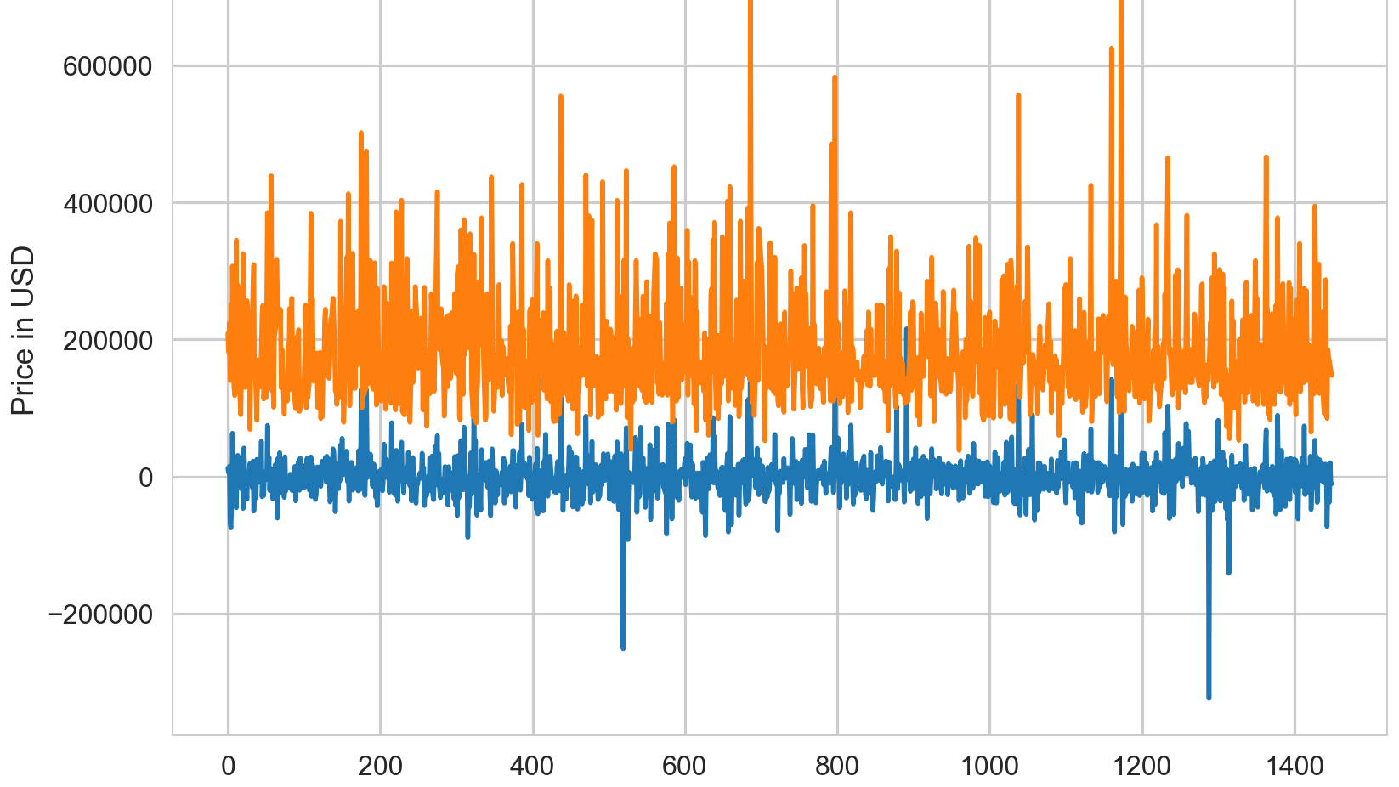
The Residuals

Slide 15
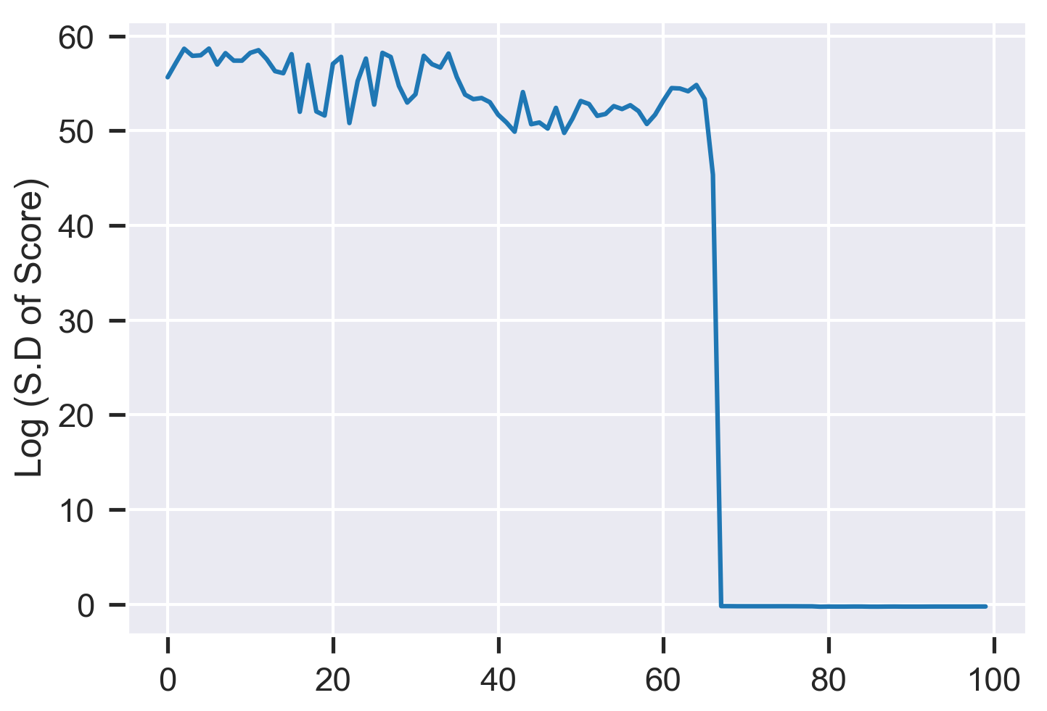
We perform a Linear Regression on Residuals using Renovatable Features (127) and use p Values and Lasso for Feature Selection down to 27.
 | Score | S.D of Score
With all 127 variables | -∞ | + ∞
With 27 p value based Variables | 0.31 | 0.75
With 27 variables and optimized Lasso | 0.16 | 0.06
Topmost Predictors
- Overall Quality
- Roof Material
- Exterior Brick Work

Slide 16
Result
We have a linear regression model that gives goodness of fit score of 0.86 on train data and 0.85 on 2010 data. The S.D of this model is 0.07 and we have a good bias – variance tradeoff.
For explaining the residuals, we have model with renovatable features that has R² of 0.16 with S.D of 0.08.
This model therefore may not be very useful for predicting if a house should be bought for renovation, however, it is still useful in focusing on which features should be considered for renovation for getting maximum chance of getting better value for renovation.

Slide 17
The Oracle of Abnormal
The highest correlation of abnormal house sale is with
Saletype Court Officer Deed/Estate – 0.34
Saletype Other – 0.17
Exterior Made from Stone – 0.13
?

